Slide 1
CHAPTER 8
SIMULATORS FOR BASIC FORMALISMS

Slide 2
OUTLINE
Simulators for DEVS
Simulator for Basic DEVS
Simulators for Modular DEVS
The Root-Coordinator
DEVS Bus
Simulator for Event Scheduling Multi-Component
Simulator for Activity Scanning and Process Interaction Multi-Component DEVS
Simulators for DTSS
Simulator for Atomic DTSS
Simulator for Instantaneous Functions
Simulator for Non-Modular Multi-Component DTSS
Simulators for Coupled DTSS
The Root-Coordinator
Simulators for DESS
Causal Simulator for DESS
Non-Causal Simulator for DESS

Slide 3
context of system formalisms
• The basic specification structure of each formalism is supported by a
class of atomic models.
For example, we can write the elements of a basic DEVS in the atomic class.
• Each such atomic class has its own simulator class.
• The coupled model structure of each formalism is supported by a class of
coupled models.
For example, we can write the elements of a coupled DEVS in the coupled class.
• Each such coupled model class has its own simulator class, called
coordinator.
• Simulator objects adhere to a generic message protocol that allows others
to coordinate with them to execute the simulation.

Slide 4
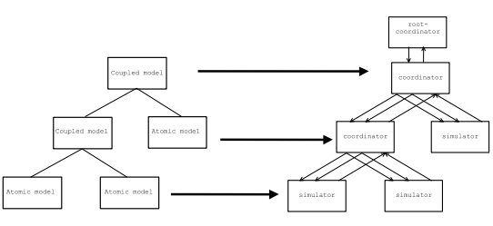
Mapping a Hierarchical Model onto a Hierarchical Simulator

Slide 5
SIMULATORS FOR DEVS
In Chapter 3 we have seen that discrete event simulation works by maintaining a list of events sorted by their scheduled event times.
Based on these general considerations,
we formulate simulation schemes for modular hierarchical DEVS.
We formulate simulators for atomic DEVS and
Coordinators for coupled DEVS.
Then we show that a hierarchical structure of simulators and coordinators correctly simulates a DEVS coupled model

Slide 6
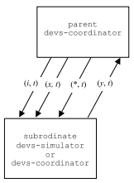
DEVS simulator protocol
An initialization method (i, t) is sent at the initialization time from the parent simulator object to all its subordinates.
The scheduling of events is done by the internal state transition message (∗,t) and are sent from the coordinator to its imminent child.
An output message (y, t) is sent from the subordinates to their parents to notify them of output events.
The input message (x, t) is sent from the coordinator to its subordinates to cause external events.

Slide 7
SIMULATOR FOR BASIC DEVS
An interpretation of the dynamics of a DEVS is given by considering the devs-simulator for DEVS.
The simulator employs two time variables (tl) and (tn).
The first holds the simulation time when the last event occurred and the second holds the scheduled time for the next event.

Slide 8
SIMULATOR FOR BASIC DEVS
From the definition of the time advance function of DEVS it follows that
tn = tl + ta(s).
Additionally, if it is given the global current simulation time t, the simulator can compute from these variables the elapsed time since the last event
e = t − tl
and the time left to the next event
σ = tn − t = ta(s) − e.
The time of next event, tn is sent to its simulator’s parent to allow for correct synchronization of events.

Slide 9
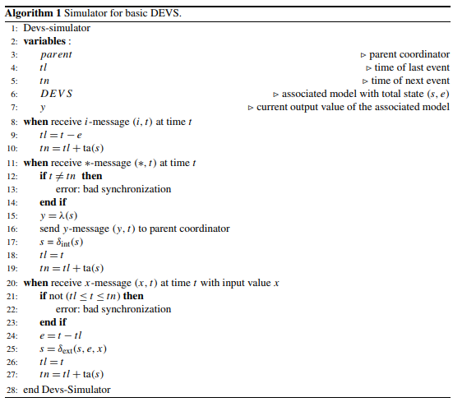
Simulator for basic DEVS Algorithm

Slide 10
SIMULATOR FOR MODULAR DEVS
In a simulator for a DEVS coupled model, each model component is handled by its own simulator.
A coordinator, assigned to the network, is responsible for the correct synchronization of the component simulators and handling of external events arriving at the network inputs.
To perform its task, the coordinator makes use of the protocols of its subordinates and provides the same protocol to its parent.

Slide 11
SIMULATOR FOR MODULAR DEVS
The coordinator implements an event list algorithm to synchronize its components.
It maintains an event list with times of next event.
This list is sorted by the event times (tn) and, when the (tn) of components are equal, by the Select function of the coupled model.
The first component in the event list defines the next internal event within the scope of the coordinator

Slide 12
SIMULATOR FOR MODULAR DEVS
This minimum next event time
tn = min{tnd |d ∈ D}
is provided to the parent of the coordinator as its next event time.
In a similar way, the time of last event of the coordinator is computed by
tl = max{tld |d ∈ D}
as the last time when an event occurred in one of the subordinate simulators.
Additionally, a coordinator has to handle input events arriving at the network’s input interface.

Slide 13
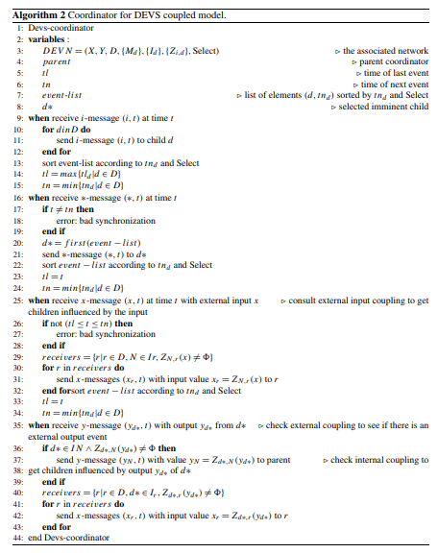
Simulator for Modular DEVS Algorithm

Slide 14
THE ROOT-COORDINATOR
The root-coordinator implements the overall simulation loop.
It accomplishes its task by sending messages to its direct subordinate.
we call the message to initiate a new simulation cycle for an event a ∗-message.
The subordinate of the root coordinator responds by reporting back its time of next state transition (tn).

Slide 15
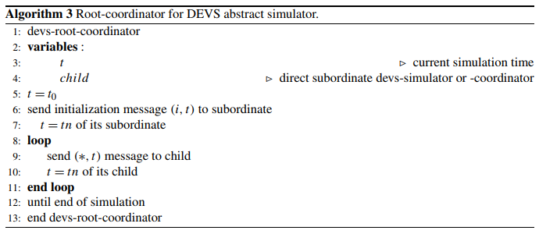
Root-coordinator for DEVS abstract simulator

Slide 16
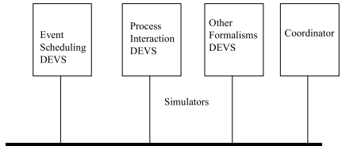
DEVS BUS
Developing simulators for event scheduling and activity scanning/process interaction formalisms.
The simulators exploit these extensions to adhere to the DEVS bus protocol.

Slide 17
SIMULATOR FOR EVENT SCHEDULING MULTI-COMPONENT DEVS
The simulator is similar to simulators of basic DEVS
but realizes its own event handling for the model components.
tl_{d} = t − e_{d}
tn_{d} = tl_{d} + ta_{d} ((..., q_{i}, ...))),
Variable :
time of last event (tl) and
time of next event (tn), as well as variables (tld) and (tnd)

Slide 18
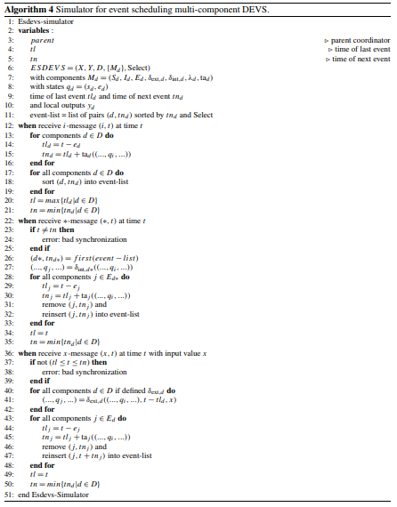
SIMULATOR FOR EVENT SCHEDULING MULTI-COMPONENT DEVS ALGORITHM

Slide 19
SIMULATOR FOR ACTIVITY SCANNING AND PROCESS INTERACTION MULTI-COMPONENT DEVS
A simulator object for activity scanning DEVS employs two lists :
The future event list (FEL)
which serves to store the events scheduled for the future.
The current-events-list (CEL)
which is used to store the components whose event times have come.

Slide 20
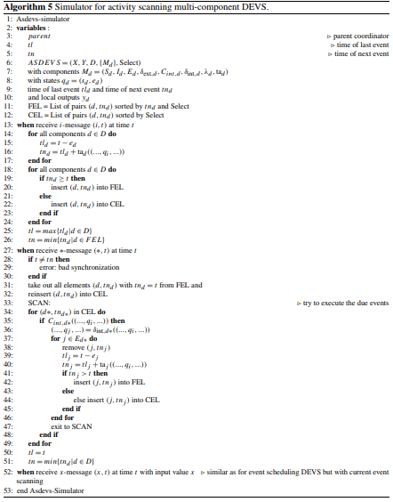
SIMULATOR FOR ACTIVITY SCANNING AND PROCESS INTERACTION MULTI-COMPONENT DEVS ALGORITHM

Slide 21
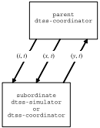
SIMULATOR FOR ATOMIC DTSS
implements the simulation algorithm for an atomic DTSS (of the Moore-type).
DTSS simulator provides two messages at each time step.
The∗-message is used to generate the output and
the x-message is used to execute the state transition.
DTSS simulator protocol.

Slide 22
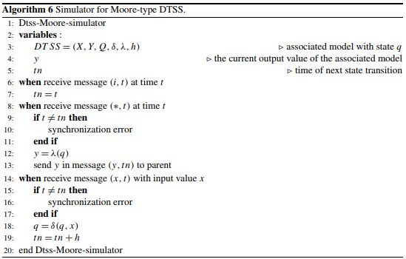
SIMULATOR FOR ATOMIC DTSS ALGORITHM

Slide 23
SIMULATOR FOR INSTANTANEOUS FUNCTIONS
Function specified systems (FNSS) are elementary systems.
The fnss-simulator simply has to react to (x)-messages at any time step (t) by the computation of the output λ(x).
For input segments ω : [t₁,t_{m}) → X

Slide 24
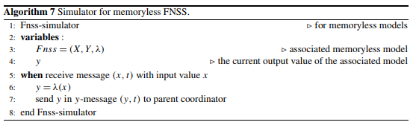
SIMULATOR FOR INSTANTANEOUS FUNCTIONS ALGORITHM

Slide 25
SIMULATOR FOR NON-MODULAR MULTI-COMPONENT DTSS
Multi-component DTSS are DTSS with several components
looks similar to a simulator for Moore-type DTSS.
In the ∗-message, the output values of all components are computed and the overall output is sent back to the parent in a y-message.
In the x-message, the new states are computed and stored in temporary variables, q d .

Slide 26
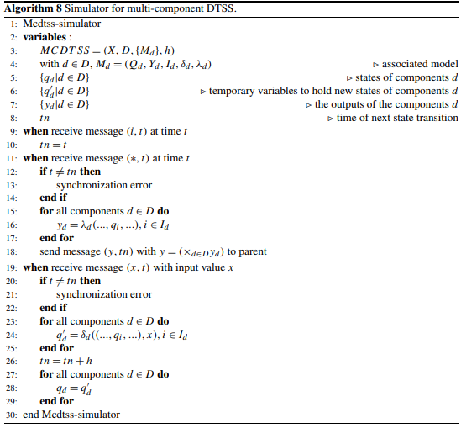
SIMULATOR FOR NON-MODULAR MULTI-COMPONENT DTSS ALGORITHM

Slide 27
SIMULATORS FOR COUPLED DTSS
define a coordinator for networks of DTSS.
A coordinator for a DTSS network uses the protocol of its subordinates, it sends i, ∗, and x-messages, and receives y-messages.
The main task of the dtss-coordinator (Algorithm 9) is to schedule the components in the right sequence.

Slide 28
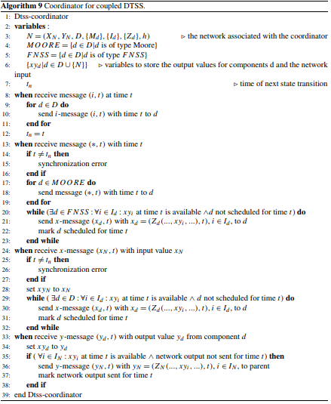
SIMULATORS FOR COUPLED DTSS ALGORITHM

Slide 29
Root-coordinator for DTSS abstract simulator
The root-coordinator for a DTSS abstract simulator has to initiate the stepwise execution of the overall DTSS simulation cycles.
It accomplishes its task by sending ∗-messages followed by x-messages (with possibly empty input value x) to its subordinate every state transition time, tn (Algorithm 10).
From the root-coordinator we require that it provides the correct synchronization for its subordinate.

Slide 30
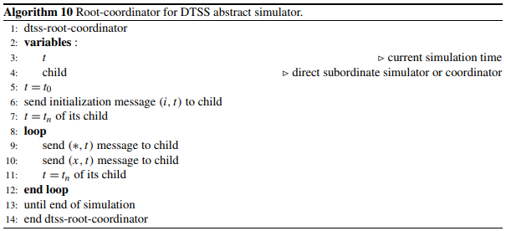
Root-coordinator for DTSS abstract simulator Algorithm

Slide 31
SIMULATORS FOR DESS
relatively simple as they employ a discretized time base.
a next state function to determine how the state at a particular time instant is computed given the state and the input at the previous time instant.
two main categories of integration methods – causal and non-causal methods.

Slide 32
CAUSAL SIMULATOR FOR DESS
To implement a causal method of order m, a simulator must save the m past values of the model state values, q, derivatives, r, and inputs, x.
With them, and the simulation step size h, the causal integration method determines an estimate for the state at the time instant t_{i+1} = t_{i} +h by
q(t_{i+1}) = CausalMethod([q(t_{i−m−1}), ..., q(t_{i})],[r(t_{i−m−1}), ..., r(t_{i})],[x(t_{i−m−1}), ..., x(t_{i})], h)

Slide 33
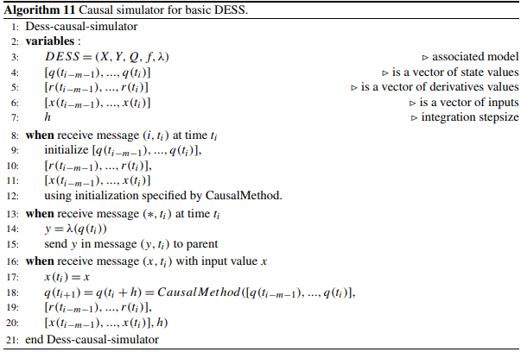
CAUSAL SIMULATOR FOR DESS Algorithm

Slide 34
NON-CAUSAL SIMULATOR FOR DESS
non-causal integration methods work in phases.
A DESS simulator with a non-causal method (Algorithm 12), therefore, has to provide for these different phases.
As for a causal method, a simulator using a non-causal method may employ vectors to store the m past state, derivative, and input values.

Slide 35
NON-CAUSAL SIMULATOR FOR DESS
In addition, it also needs vectors to store n predicted values.
In one simulation cycle, in n predictor phases the vectors q (i) for i = 1, ..., n are filled by
q’ (k + 1) = kth − Predictor([q(t_{i−m−1}), ..., q(t_{i}), q’ (1), ..., q’ (k)], [r(t_{i−m−1}), ..., r(t_{i}), r’ (1), ..., r’ (k)],[x(t_{i−m−1}), ..., x(t_{i}), x’ (1), ..., x’ (k)], h)

Slide 36
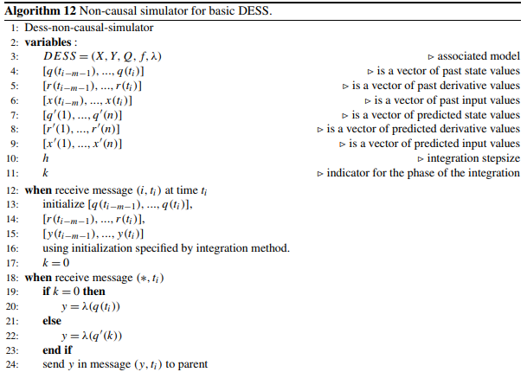
NON-CAUSAL SIMULATOR FOR DESS Algorithm

Slide 37
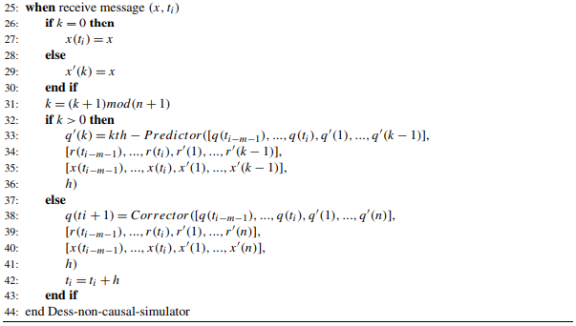
NON-CAUSAL SIMULATOR FOR DESS Algorithm

